Slide 1
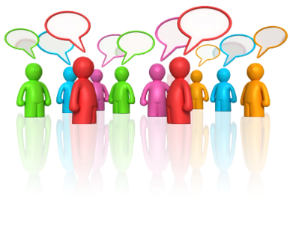
AS English Language: Language and Social Contexts Language and Power: Using Frameworks to Analyse Talk

Slide 2
Basic questions when analysing talk…
Who seems to lead the talk?
This means looking closely at how the talk moves on as each speaker takes his or her turn. These alternating turns are referred to as adjacency pairs. In some situations, the pattern may be obvious ‑ a teacher or a police officer may ask all the questions, for instance.

Slide 3
Basic questions when analysing talk…
Who says what gets talked about?
The ability to influence the subject or ‘agenda’ of a conversation is usually a sign of personal status or dominance. In formal talk, the agenda and who controls it (or topic management, as this aspect of talk is known) may be obvious; in informal situations, where many topics may be covered, we need to look more closely at whose subjects get talked about and whose don’t.

Slide 4
Basic questions when analysing talk…
Who talks most?
Always a key question, but the answer to this question will not always lead us to the dominant speaker. Sometimes, the most powerful person needs to say very little.

Slide 5
Basic questions when analysing talk…
Who interrupts? Who backs down?
This is usually an interesting question. If someone is easily interrupted this may be a sign of low status, whereas the right to speak uninterrupted is often an indicator of conversational dominance.

Slide 6
Basic questions when analysing talk…
Who gets to comment on what people say?
In classrooms, teachers routinely say in response to students ‘Good answer’, ‘Well done’, or ‘That’s right’ (or their opposites). However, when a teacher asks a particularly searching question, students seldom say, ‘Good question, sir’. The right to make judgements about what other people say is often a sign of status or power.

Slide 7
Basic questions when analysing talk…
What are people trying to do to other speakers? … Or, what do people really mean?
When we start to talk about the weather, is it always because we are obsessed with meteorology, or is it simply a way of saying to each other ‘Let’s talk. Let’s be friendly’? The study of what we really mean and intend with our speech is called pragmatics.
‘Small talk’ that has no real meaning (such as ‘How are you?’) is often called phatic talk or a phatic token.

Slide 8
An Analytical Framework

Slide 9
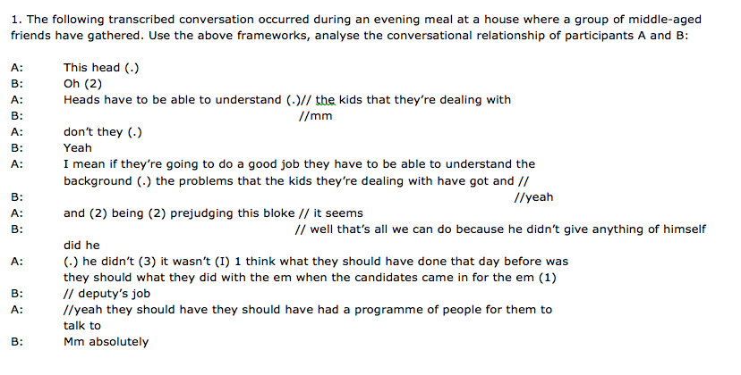
Transcript starts with ‘A’ leading this part of the conversation, and at first ‘B’ doesn’t make a serious attempt to seize the floor or attempt to change the topic.
B’s first comments ‑ ‘Oh’, ‘mm’ and ‘Yeah’ – are typical minimal responses (i.e. brief utterances that signal sympathetic encouragement and assure A that B is listening)
You have 30 mins to fully analyse the transcript. Use the grid and any other Lang and Power content we have covered.
However, A’s speech shows some signs of non‑fluency with the two 2‑second pauses and the breakdown of grammatical sense (‘and (2) being (2) prejudging this bloke’), which prompts B to ‘help out’ by providing the supportive ‘//well that’s all we can do’. However, by ending this turn with ‘did he’, a question tag, B in effect yields the floor to A.
A similar pattern can be seen in the next pair of turns. A pauses twice, but B refrains from interrupting, waiting instead until A seems to stumble over a phrase (‘deputy’s job’), which B helpfully suggests before giving way again. A is allowed to finish, and B adds the supportive agreement ‘absolutely’.
So B is certainly behaving in a very co‑operative and helpful way, granting the floor and topic control to A, providing supportive minimal responses and even completing A’s utterances when A seems to be stumbling.

Slide 10
Face and Politeness TEST
Who wrote about ‘face’ in conjunction with how people interact in daily life?
What do we protect when we interact socially?
What do we call a process combining line and face (or face work)?
Which theorists use the concept of ‘face’ to explain politeness?
Explain POSITIVE and NEGATIVE face.
Name the FOUR varieties of Face Threatening Acts.
Give an example of a baldly FTA with no politeness.
What is the purpose of a politeness strategy?
What are the FOUR types of politeness strategy?
Name the politeness strategy used here: “Hmmm, I sure could use a blue pen right now.”
Notes:
1. Erving Goffman 2.Identity/Public Self-Image 3. Social Interaction 4. Brown and Levinson 5. Positive – desire to be liked, appreciated, approved Negative – desire not to be imposed upon, intruded 6. Baldy (no politeness), Positive Politeness, Negative Politeness, Indirectly 7. “Close your mouth when you eat, you swine!” 8. To save the hearers’ face 9. Bald On Record, Negative, Positive, Off-Record-indirect strategy. 10. Off-Record-indirect.

Slide 11
1. Erving Goffman
2.Identity/Public Self-Image
3. Social Interaction
4. Brown and Levinson
5. Positive – desire to be liked, appreciated, approved; Negative – desire not to be imposed upon, intruded
6. Baldy (no politeness), Positive Politeness, Negative Politeness, Indirectly
7. “Close your mouth when you eat, you swine!”
8. To save the hearers’ face
9. Bald On Record, Negative, Positive, Off-Record-indirect strategy.
10. Off-Record-indirect.

Slide 12
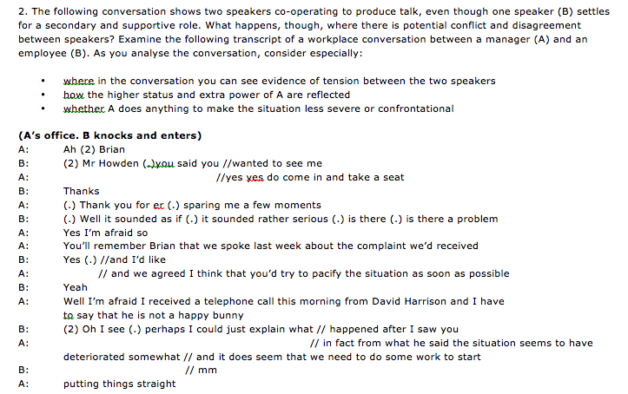

Slide 13
Analysis
At first we notice A’s rather cool greeting – “Ah” – and forms of address used (A assumes the right to use B’s first name, B refers to A as ‘Mr Howden’).
Some initial pauses may indicate tension; a speaker of equal status might not have waited as long before taking the first turn as B does here.
By contrast, A interrupts and overlaps with B, and the repeated yes’ may hint at some impatience. A’s control is also reflected by ‘take a seat’; the right to dominate a conversation often reflects the right to control the space in which it takes place.
Even though this is a tricky conversation, both participants observe basic politeness strategies, with A pretending that B has come out of choice, as opposed to having been summoned by his boss.
After this initial phatic exchange, B takes the initiative (‘is there a problem’) and A softens his response with the phrase ‘I’m afraid’, which allows him to imply that although he may have to reprimand B, he regrets having to do so.

Slide 14
Analysis Cont…
However, once the exchange is under way, A asserts his power in many ways. Despite the informality of the form of address –use of contraction and first name address- (‘You’ll remember Brian’), the tone is rather formal and severe.
B attempts to interrupt as if to clarify what may have happened since their last meeting but A refuses to yield the floor.
The attempted interruption having failed, A presses on to the point, though again softening his implied reprimand with the phrase ‘I think’. This kind of qualifying phrase is called a hedge.
B is then reduced to making a minimal response (‘Yeah’) as A again softens the complaint with ‘I’m afraid’ before using the euphemistic figure of speech ‘not a happy bunny’.
B is again cautious about seizing the floor ‑ waiting for 2 seconds before attempting an explanation. Even then, he is allowed only a few moments before A again interrupts with ‘in fact…’. Once again, having been interrupted, B is reduced to accepting his junior status and signals this with a minimal response (‘mm’).

Slide 15
Analysis Cont…
A continues to soften his language with another hedge (‘it does seem’), but it is clear that what is grammatically a declarative (‘we need to do some work’) is actually an implied rebuke and imperative.
There is also the interesting use of the first person plural here; ‘we’ seems to imply only B, as it his job to put the problem right, but it feels slightly less harsh than the more direct second person ‘you’. (Negative Politeness strategy)
So, although A asserts power by controlling the agenda and turn‑taking in the conversation, he takes care to soften the harshness of the reprimand and command he is delivering, and the somewhat tense conversation retains a superficial politeness and civility.

Slide 16
Face Theory
Erving Goffman wrote about face in conjunction with how people interact in daily life.
He claims that everyone is concerned, to some extent, with how others perceive him or her. We act socially, striving to maintain the identity we create for others to see. This identity, or public self-image, is what we project when we interact socially.

Slide 17
Face Theory
Brown and Levinson use the concept of face to explain politeness. To them, politeness is universal, resulting from people’s face needs:
Positive face is the desire to be liked, appreciated, approved, etc.
Negative face is the desire not to be imposed upon, intruded, or otherwise put upon.
“Positive politeness” addresses “positive face” concerns, often by showing pro-social concern for the other’s face. “Negative politeness” addresses “negative face concerns”, often by acknowledging the other’s face is threatened. Anytime a person threatens another person’s face, the first person commits a “face-threatening act” (FTA). Face-threatening acts come in four varieties, listed below in order from most to least face threatening:

Slide 18
Face Theory
Do an FTA with no politeness (e.g., “Close your mouth when you eat, you swine.”).
Do an FTA with positive politeness (e.g., “You have such beautiful teeth. I just wish I didn’t see them when you eat.”).
Do an FTA with negative politeness (e.g., “I know you’re very hungry and that steak is a bit tough, but I would appreciate it if you would chew with your mouth closed.”).
Do an FTA indirectly, or off-record (e.g., “I wonder how far a person’s lips can stretch yet remain closed when eating?”). An indirect FTA is intentionally ambiguous so the receiver may “catch the drift” but the speaker can also deny a meaning if they wish.
Of course, a person can choose not to threaten another’s face at all, but when a face must be threatened, a speaker can decide how threatening he or she will be.

Slide 19
POLITENESS
In everyday conversation, there are ways to go about getting the things we want. When we are with a group of friends, we can say to them, “Go get me that plate!”, or “Shut-up!”
However, when we are surrounded by a group of adults at a formal function, which our parents are attending, we must say, “Could you please pass me that plate, if you don’t mind?” and “I’m sorry, I don’t mean to interrupt, but I am not able to hear the speaker in the front of the room.”
In different social situations, we are obligated to adjust our use of words to fit the occasion. It would seem socially unacceptable if the phrases above were reversed.

Slide 20
POLITENESS
According to Brown and Levinson, politeness strategies are developed in order to save the hearers’ face. Face refers to the respect that an individual has for him or herself, and maintaining that “self-esteem” in public or in private situations.
Usually you try to avoid embarrassing the other person, or making them feel uncomfortable.
Face Threatening Acts (FTA’s) are acts that infringe on the hearers’ need to maintain his/her self-esteem, and be respected. Politeness strategies are developed for the main purpose of dealing with these FTA’s. What would you do if you saw a cup of pens on your teacher’s desk, and you wanted to use one, would you:

Slide 21
POLITENESS
Say, “Ooh, I want to use one of those!”
Say, “So, is it O.K. if I use one of those pens?”
Say, “I’m sorry to bother you but, I just wanted to ask you if I could use one of those pens?”
Indirectly say, “Hmm, I sure could use a blue pen right now.”

Slide 22
POLITENESS
Brown and Levinson describe four types of politeness strategies that sum up, as they see it, human “politeness strategies”:
Bald On Record
Negative Politeness
Positive Politeness
Off-Record-indirect strategy

Slide 23
POLITENESS
If you answered A, you used what is called the Bald On-Record strategy - this provides no effort to minimize threats to your teacher’s “face.”
If you answered B, you used the Positive Politeness strategy. In this situation you recognise that your teacher has a desire to be respected. It also confirms that the relationship is friendly and expresses group reciprocity.
If you answered C, you used the Negative Politeness strategy. This is similar to Positive Politeness in that you recognise that they want to be respected however, you also assume that you are in some way imposing on them. Some other examples would be to say, “I don’t want to bother you but…” or “I was wondering if …”
If you answered D, you used Off-Record indirect strategy. The main purpose here is to take some of the pressure off you. You are trying not to impose directly by asking for a pen; instead, you would rather it be offered to you once the teacher realizes you need one, and you are looking to find one. A good example of this strategy is something that almost everyone has done or will do when they have, on purpose, decided not to return someone’s phone call; therefore, they say, “ I tried to call a hundred times, but there was never any answer.”

Slide 24
“Bald on-record”
These provide no effort by you to reduce the impact of the FTA’s. You will most likely shock the person you are speaking to, embarrass them, or make them feel a bit uncomfortable. However, this type of strategy is commonly found with people who know each other very well, and are very comfortable in their environment, such as close friends and family).
An Emergency:
HELP!!
Task oriented:
Give me that!
Request:
Put your coat away.
Alerting:
Turn your headlights on! (When alerting someone to something they should be doing).

Slide 25
“Positive Politeness”
Usually seen in groups of friends, or where people in the given social situation know each other fairly well. It usually tries to minimize the distance between them by expressing friendliness and solid interest in the hearer’s need to be respected (minimize the FTA).
Attend to the hearer:
“You must be hungry, it’s a long time since breakfast. How about some lunch?”
Avoid disagreement:
A: “ What is she, small?”
B: “Yes, yes, she’s small, smallish, um, not really small but certainly not very big.”
Assume agreement:
“So when are you coming to see us?”
Hedge opinion:
“You really should sort of try harder.”

Slide 26
“Negative Politeness”
The main focus for using this strategy is to assume that you may be imposing on the hearer, and intruding on their space. Therefore, these automatically assume that there might be some social distance or awkwardness in the situation.
Be indirect:
“I’m looking for a comb.”
In this situation you are hoping that you will not have to ask directly,
so as not to impose and take up the hearer’s time. Therefore, by
using this indirect strategy, you hope they will offer to go find one
for you.
Use an apology or ask for forgiveness:
“You must forgive me but....”
Minimize imposition:
“I just want to ask you if I could use your computer?”
Pluralize the person responsible:
“We forgot to tell you that you needed to by your plane ticket by yesterday.”
This takes all responsibility off of only you and onto “we”, even if you were the person responsible for telling the hearer when the deadline was to buy the ticket.

Slide 27
“Off-Record” (indirect)
Here you are removing yourself from any imposition on the other party whatever.
Give hints:
“It’s cold in here.”
Be vague:
“Perhaps someone should have been more responsible.”
Be sarcastic, or joking:
“Yeah, he’s a real rocket scientist!”

Slide 28
Why Conversation Works (when it shouldn't’t…) according to theorists… Grice, Goffman, Brown, Levinson and Leech
A Level English Language

Slide 29
Grice’s ‘Logic of Conversation’
Conversation works - even when we don’t say what we mean.
Why it works so well fascinated philosopher Paul Grice. He wondered about conversations such as this:
Jack: You’ve got a mountain to climb!
Lily: It’s better than a slap in the face.
Grice wondered just how we make meaning out of such conversation.

Slide 30
Grice’s ‘Logic of Conversation’
Grice concluded that conversation must follow its own set of logical principles or ‘rules’.
He worked out how, even when we don’t mean what we say – that the full ‘pragmatic force’ of our utterance is easily understood, as in this third example:
Lily: This bottle’s half empty already!
Jack: Gosh - is that the time already?

Slide 31
Grice’s Insights
Communication is a co-operative activity: when two people communicate, it’s in their interests to make the communication go as smoothly as possible in order to achieve their aims.
Speakers behave in certain predictable ways.
When we, as hearers, try to work out what someone means, we do it by assuming they’re being co-operative.

Slide 32
Grice’s ‘Co-operative Principle’
“Make your conversational contribution such as is required, at the stage at which it occurs, by the accepted purpose and direction of the exchange in which you are engaged.”
Conversation works only with the co-operation of its participants.
Co-operation is built around a series of ‘Gricean maxims’:
Quality
Quantity
Manner
Relation

Slide 33
Gricean Maxims 1. Quality
“Do not say what you believe to be false.”
“Do not say that for which you lack evidence.”
So… when someone speaks to us, we assume:
that what they say is not knowingly untruthful;
that the truthfulness of what they say does not need to be made stated.

Slide 34
Gricean Maxims 2. Quantity
“Make your contribution as informative as is required.”
“Do not make your contribution more informative than is required.”
So… when someone speaks to us, we assume:
they do not purposefully hold back anything that is important;
they do not give more information than is asked.

Slide 35
Gricean Maxims 3. Manner
“Be perspicuous.”
“Avoid obscurity of expression.”
“Avoid ambiguity.”
“Be brief.”
“Be orderly.”
So… when someone speaks to us, we assume:
that what they say is being said as straightforwardly as they can say it.

Slide 36
Gricean Maxims 4. Relevance
“Be relevant.”
So… when someone speaks to us , we assume:
that what they say is relevant to the conversation.

Slide 37
‘The Gricean Maxims’
Be true
Be brief
Be clear
Be relevant
‘In short, these maxims specify what the participants have to do in order to converse in a maximally efficient, rational, co-operative way: they should speak sincerely, relevantly and clearly whilst providing sufficient information.’
Levinson (1983)

Slide 38
The maxims in action…
“How do I get to Sainsbury’s, mate?”
“Go straight ahead, turn right at the school, then left at the bus stop on the hill.”
Speaker A assumes that:
B believes his directions to be genuine – the maxim of quality;
B believes the information to be sufficient – the maxim of quantity;
B believes the information to be clear – the maxim of manner;
B believes his directions are to Sainsbury’s – the maxim of relation.

Slide 39
Not following the maxims…
Grice recognised that whilst we could choose not to follow a maxim, such a choice would be conscious and consequential.
A speaker can choose to…
‘violate’ a maxim and be intentionally misleading.
‘opt out’ of a maxim and refuse to co-operate.
deal with a ‘clash’ of maxims, for instance, between saying enough and saying all that we know to be true.
‘flout’ a maxim and be intentionally ironic.

Slide 40
‘Violating’ a Maxim
In this BBC interview between Jeremy Paxman and Michael Howard, the leader of the opposition violates the maxim of relation by not giving an answer that relates to the question:
Paxman: Did you threaten to overrule?
Howard: I was not entitled to instruct Derek Lewis and I did not instruct him.
Paxman: Did you threaten to overrule him?
Howard: The truth of the matter is that.

Slide 41
‘Opting out’
Here, Paxman asks the Prime Minister a question; the minister opts out of the maxim of relation:
Paxman: “When will war become inevitable?”
PM: “Well I know you have to ask that question but it’s the kind of question I cannot answer.”

Slide 42
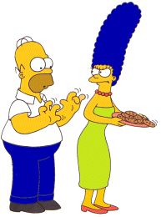
‘Flouting’
This is the most important ‘use’ of Grice’s maxims.
Unlike ‘violating’, ‘flouting’ a maxim allows a speaker to signal that although they seem to be ‘violating’ a maxim, they are still co-operating.
“Mmm… Do’nuts…”
“Homie, those pants look awful tight to me.”
Which leads us very nicely on to Grice’s key idea of “Implicature”…

Slide 43
‘Conversational Implicature’ ‘Gricean Pragmatics’ – knowing what isn’t said
What Grice called ‘implicature’ occurs when a speaker chooses to flout a maxim.
The listener, assuming that the speaker still intends being cooperative, looks for meaning other than that which is said.
The intended meaning will be arrived at through the speaker working out the pragmatic force of the utterance rather than its semantic sense.

Slide 44
Implicature Flouting the maxim of quantity…
A: I hear you went to the theatre last night; what play did you see?
B: Well, I watched a number of people stand on the stage in Elizabethan costumes uttering series of sentences which corresponded closely with the script of Twelfth Night.
Here, B’s verbose answer, although it doesn’t say anything more than “I saw a performance of Twelfth Night,” invites A to infer that the performers were doing a miserably bad job of acting.

Slide 45
Implicature Flouting the maxim of quality
A: What are you baking?
B: Be i are tee aitch dee ay wye see ay kay ee.
By answering obscurely, B conveys to A the implicature that the information is to be kept secret from the young child who is in the room with them.

Slide 46
Implicature Flouting the maxim of manner
When discussing an essay with a student, it is customary for a teacher to be polite and to find things to praise…
“So let me say straight away, James, that your essay is beautifully printed, the font has been immaculately well chosen and the positioning of those staples is a work of sheer genius...”

Slide 47
How the implicature works…
To James, such a comment is apparently not relevant to what he wants to hear – so he assumes his teacher has ‘flouted the maxim’ of relevance.
BUT… James assumes the teacher is still co-operating in the conversation by taking his ‘conversational turn’ leaving James to assume he is trying to convey something relevant about the quality of the essay.
SO… If James assumes the essay is other than worthless, then the teacher is observing the co-operative Principle.
The listener assumes that the speaker assumes that the listener can work it out.

Slide 48
Grice’s Maxims In Writing?
Many kinds of communication operate as ‘interactions’ – a sort of ‘one sided’ conversation – letters, advertisements, and so on. Applying Grice’s maxims to written texts can allow you to develop subtle insights.
Flouting Grice’s maxims is more difficult in writing because it’s less easy to make sure that your reader understands what is happening.
This can be especially important in the ‘Language and Technology’ topic where much writing is ‘conversational’… but lacks the prosody and body-language of face-to-face interaction.

Slide 49
Grice’s Maxims and Implicature can be applied well beyond conversation…
What maxims are being flouted here?
What implicatures are being created?
To what effect?
For what purpose?

Slide 50
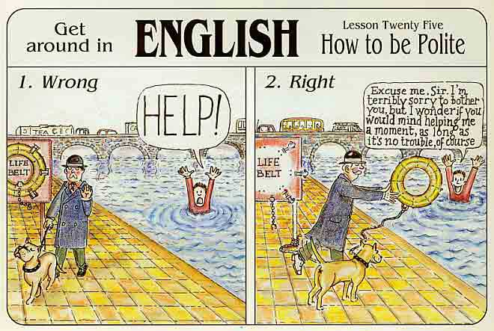
POLITENESS
If we really want co-operation…
… we also need to be polite

Slide 51
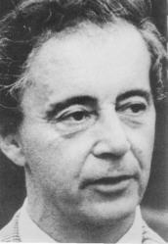
Goffman’s Face
Co-operation is vital to conversation, but without politeness, all is lost.
Erving Goffman was intrigued by what lay behind everyday expressions such as ‘losing face’, ‘saving face’ and ‘being shamefaced’.
He saw that without politeness, conversation didn’t work and that the need for politeness was rooted in ‘saving face’: ‘[face is…] the positive social value a person effectively claims for himself by the line others assume he has taken during a personal contact’
Goffman recognised that whenever we talk, we need to feel ‘liked’.
As a consequence, conversations are sites for potential ‘loss of face’ and that ‘face work’ must, therefore, be a part of talk if ‘loss of face’ is to be avoided and co-operation is to be maintained.

Slide 52
‘Negative’ and ‘Positive’ Face
Brown and Levinson developed Goffman’s ideas into the concepts of ‘positive’ and ‘negative’ face.
‘Negative’ Face
The desire to feel unimpeded, i.e. the freedom from feeling imposed upon by the interaction.
‘Positive’ Face
The desire to feel approved of , i.e. to maintain a positive and consistent self-image during the interaction.

Slide 53
‘Negative and Positive Face’
‘Face Threatening Acts’ (FTAs)
conversational turns that risk a ‘loss of face’.
Positive politeness ‘face work’
addresses ‘positive face’ concerns, by showing concern for the other’s face.
Negative politeness ‘face work’
addresses ‘negative face’ concerns, by acknowledging the other’s face is threatened.

Slide 54
‘Face Threatening Acts’
‘Close your mouth when you eat, you fat swine’.
A bald FTA
‘You have such beautiful teeth. I wish I didn’t see them when you eat.’
An FTA using positive politeness
‘I know you’re very hungry and that steak is a bit tough, but I would appreciate it if you would chew with your mouth closed.’
An FTA using negative politeness
‘I wonder how far a person’s lips can stretch yet remain closed when eating?’
An ‘off record’ or ‘indirect’ FTA

Slide 55
The ‘Politeness Principle’
Geoffrey Leech proposed the need for ‘politeness maxims’ as a prerequisite for conversational co-operation.
In the absence of politeness, Leech suggested, it will be assumed that an attitude of politeness is absent.
Each maxim has two forms: positive and negative.
Each maxim has a lesser ‘sub-maxim’ that recognises the general law that negative politeness – that we seek to minimise discord – is more important than positive politeness – that we seek concord.

Slide 56
Leech’s Politeness Maxims (1)
Tact: minimise the cost to others [‘sub-maxim’: maximise benefit to others]
Generosity: minimise benefit to self [maximise cost to self]
Approbation: minimise dispraise of others [maximise praise of other]

Slide 57
Leech’s Politeness Maxims (2)
Modesty: minimise praise of self [maximise dispraise of self]
Agreement: minimise disagreement between self and others [maximise agreement between self and other]
Sympathy: minimise antipathy between self and others [maximise sympathy between self and other]

Slide 58
Cn u fnd sm mxms, face n plitns in ths txt msg?
Co-operation & Politeness
B. Heya! Im @ a party! Wikd 2 ere frm u! Aint gt mch batri so mayb txt u 2mz? D kj xxxx
A. Hii KJ Hows u doin? Avnt cht 2 U 4 ages yano! We shud catch up sometime!! TB xxxxx
A. [next day] U av a Gud time at da party? Il b online L8R!! lol! Tb xxx

Slide 59
Politeness Task
Analyse this conversation at the level of co-operation and politeness.

