Slide 1
Language and power
Key Terminology

Slide 2
Key Terminology
Term | Definition
Influential Power | Persuasive – It inclines us or makes us want to behave in certain ways or adopt opinions or attitudes with obvious force.
Term | Definition
Instrumental Power | Explicit power of the sort imposed by the state, by its laws and conventions, or by the organisations for which we work.

Slide 3
Term | Definition
Implicature | Used to persuade people to take something for granted – forces the audience to agree – e.g. ‘we are fighting for a fairer Britain.’
Synonymous parallelism | Adding something extra/repeating the same idea in different wording.
Antithetical parallelism | Adding an opposing thought.
Jargon | Particularly specialist terminology that may exclude others.
Negative Face (Brown and Levinson) | We try to satisfy the negative face of others by, for example, accompanying requests with apologies.
Positive Face (Brown and Levinson) | We try to satisfy the positive face needs of others by greeting them, asking them how they are, showing respect, expressing admiration and approval.

Slide 4
Term | Definition
Deontic modal verbs | Obligation e.g. ‘must’
Epistemic modal verbs | Discretion e.g. ‘should, could.’
Hypernym and Hyponym | Hypernyms are generic nouns whereas hyponyms are specifics. E.g. ‘cat’ is a hyponym of ‘animal’ and ‘animal is a hypernym of ‘cat.’
Formulation | Rewording and twisting words.
Standard English and Received Pronunciation. | SE: A dialect – words and grammar – not influenced by geographical position. RP: an accent connected with higher class rather than regional origin.
Semantic Derogation. | When a negative meaning is attached to some words – e.g. ‘mistress.’

Slide 5
Group Project – ESSAY DUE MONDAY 17TH MARCH.
In your groups, you must research the following language and power theories and compose a CRITICAL reflection (essay form) as a group.
Brown & Levinson (1987)
Grice’s Maxims (1975)
Wareing (1999)
Fairclough (2001)
Goffman (1967)

Slide 6
How to write a critical reflection…
Introduction (for each piece of research)
Include a few opening sentences that briefly explain the the research - summarise the main finding or key argument. Conclude the introduction with a brief statement of your evaluation of the text. This can be a positive or negative evaluation or, as is usually the case, a mixed response.
Summary
Present a summary of the key points along with a limited number of examples.

Slide 7
Critique
The critique should be a balanced discussion and evaluation of the strengths, weakness of the research. Good reviews also include other sources (from wider reading) to support your evaluation (remember to reference them).
Conclusion
This is usually a very short paragraph.
Restate your overall opinion of the text.

Slide 8
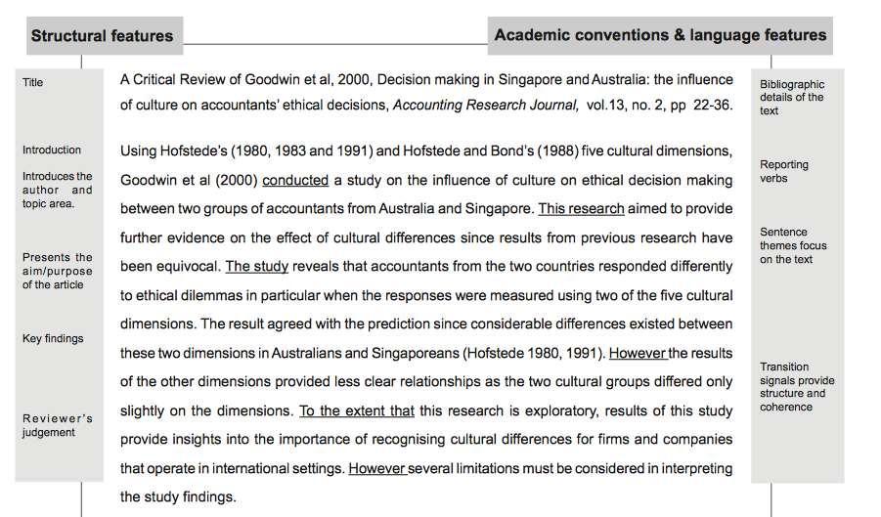
Example of a CRITICAL REVIEW:

